Slide 1
Plot prototypes

Slide 2
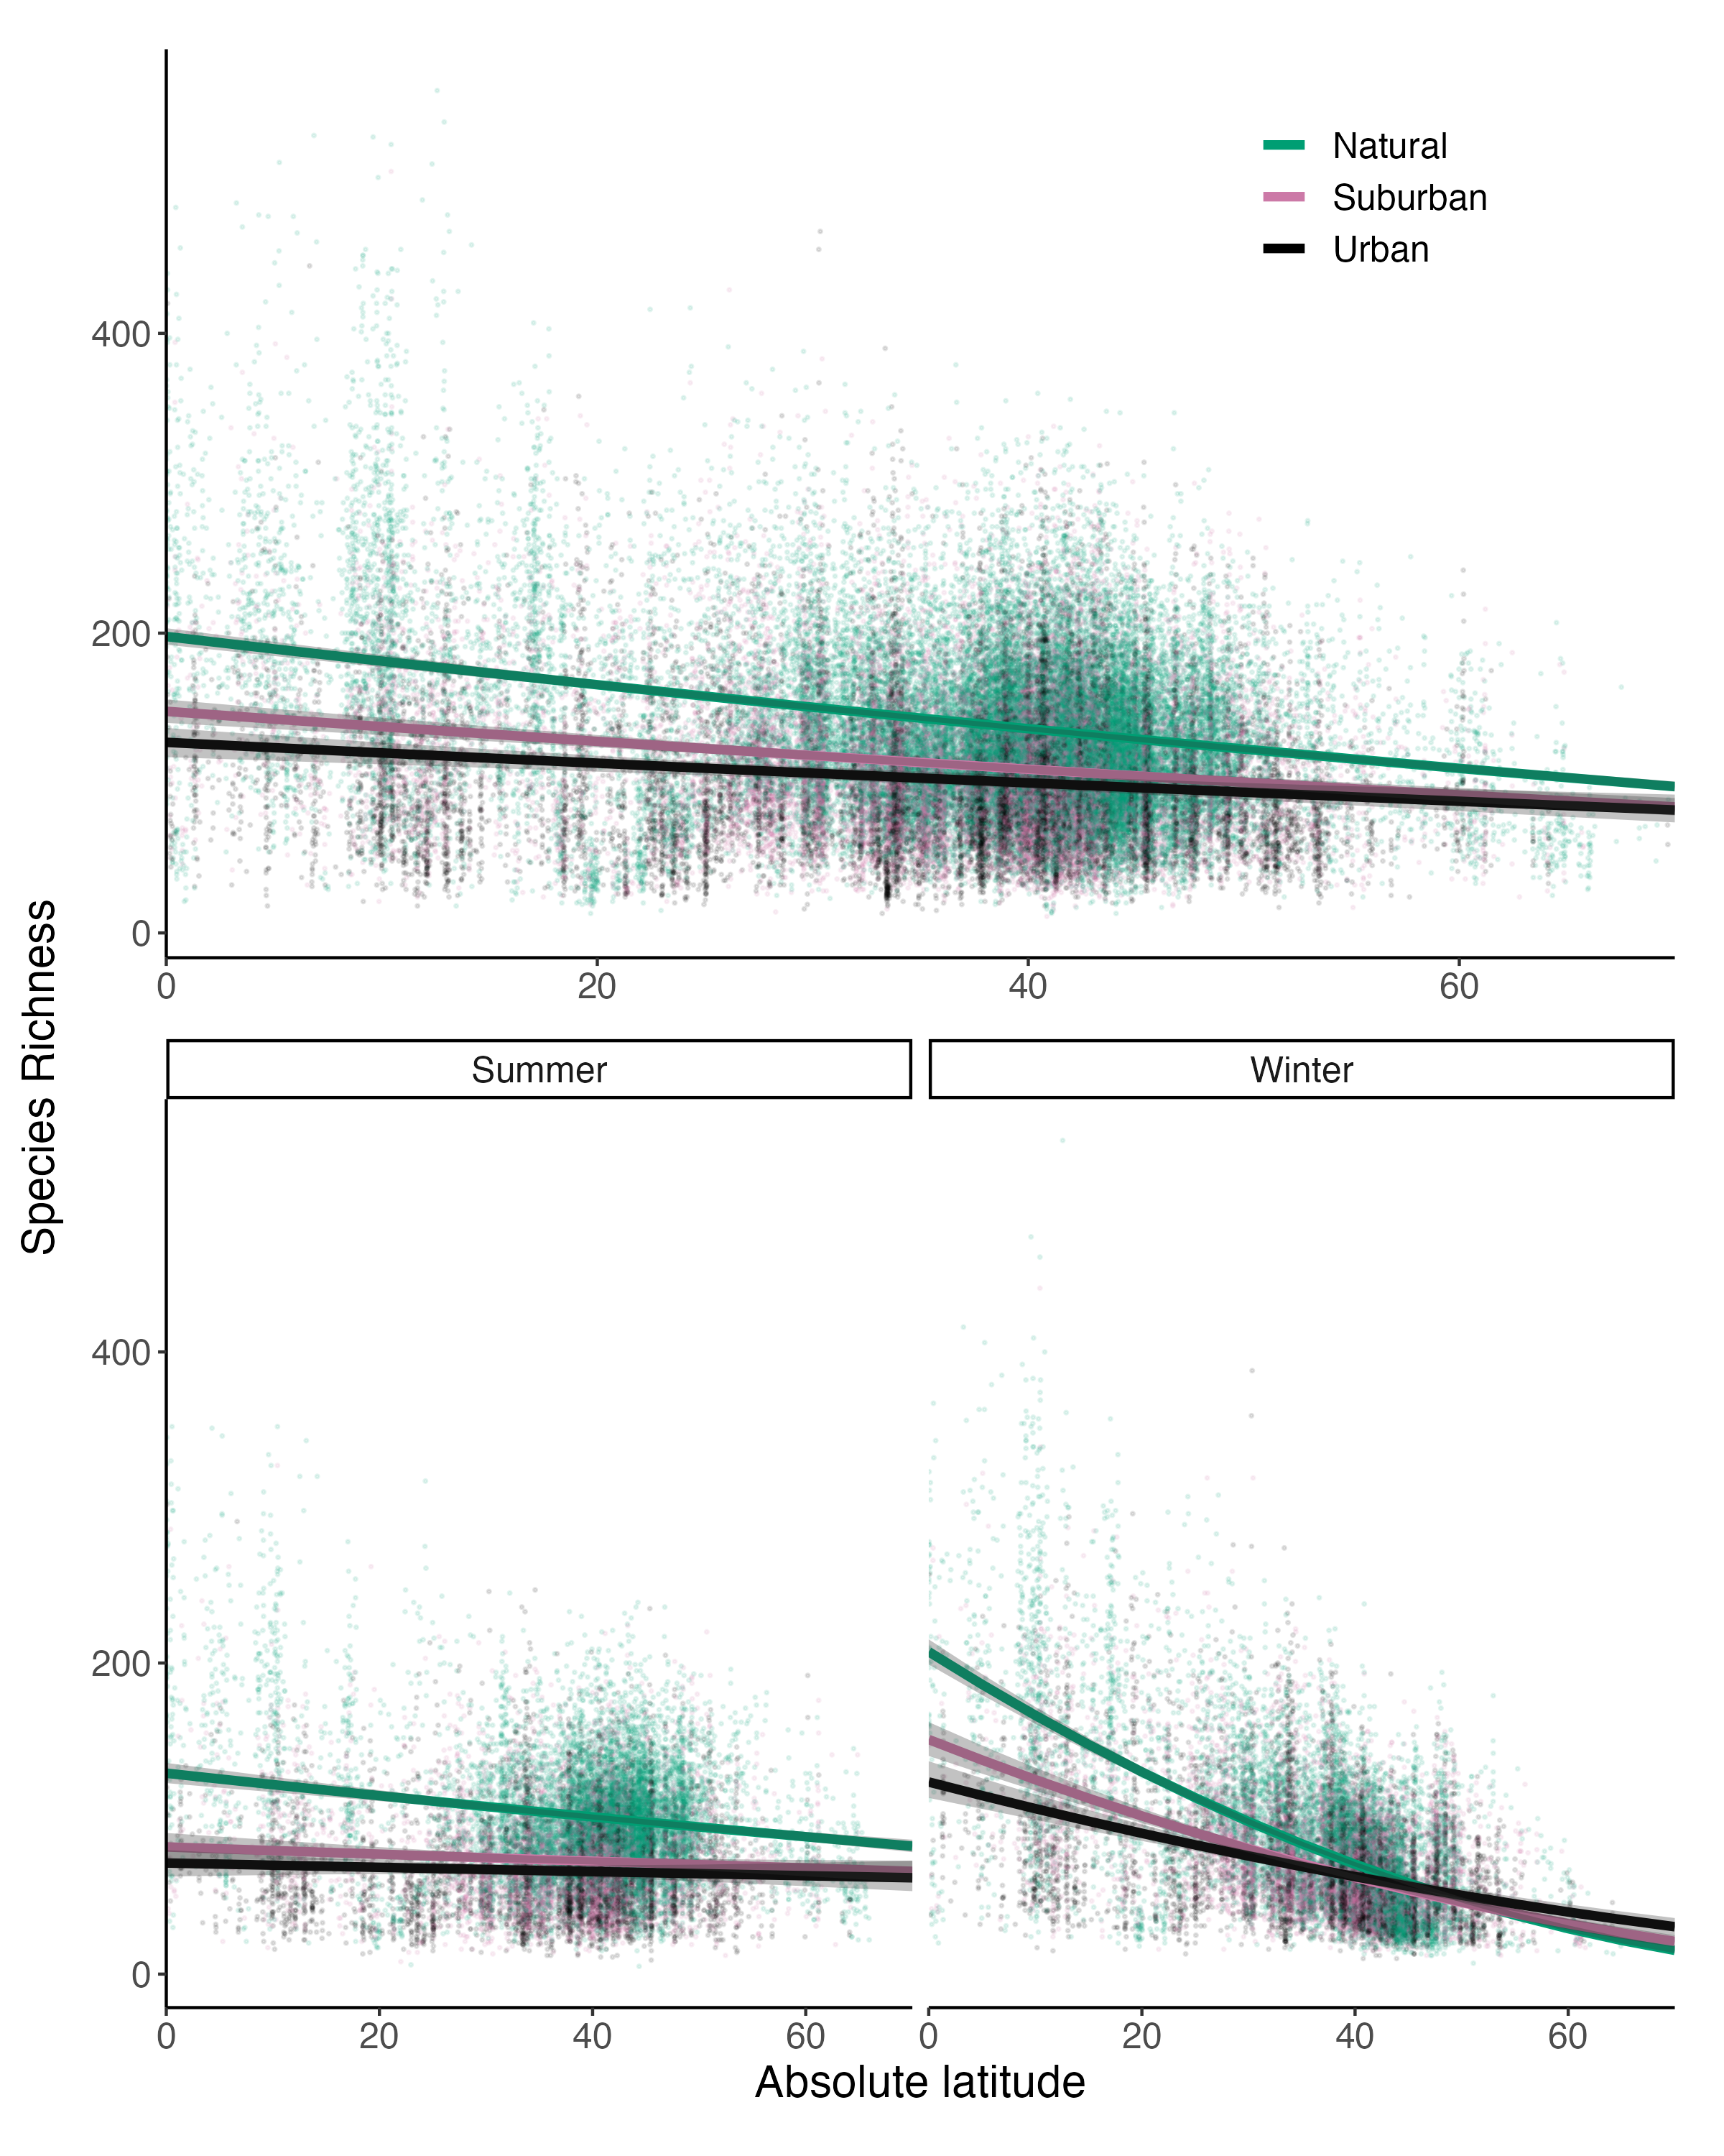
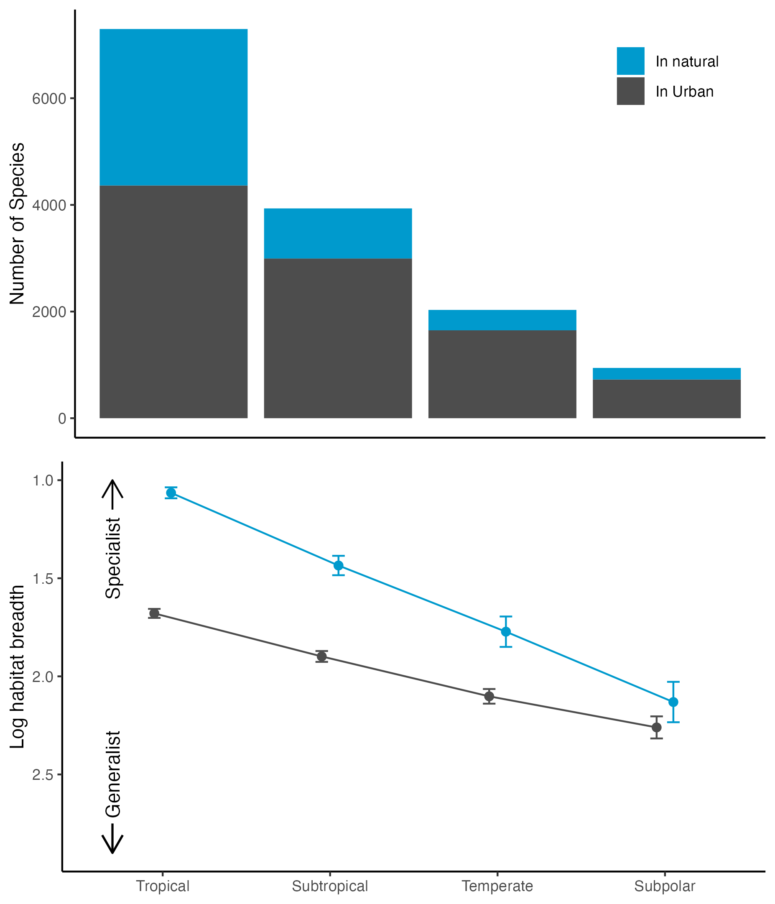
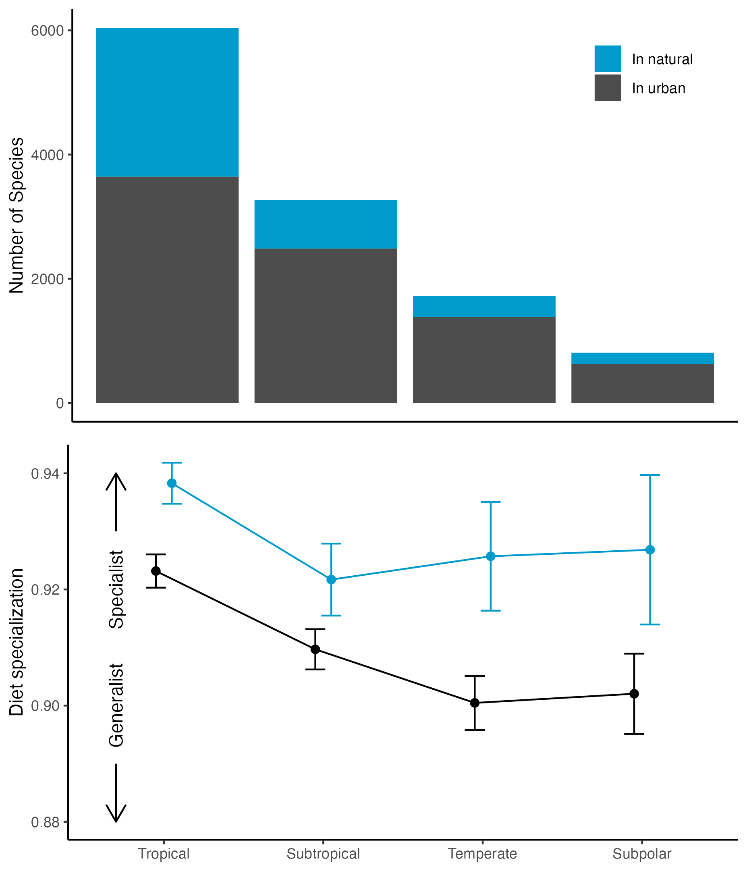
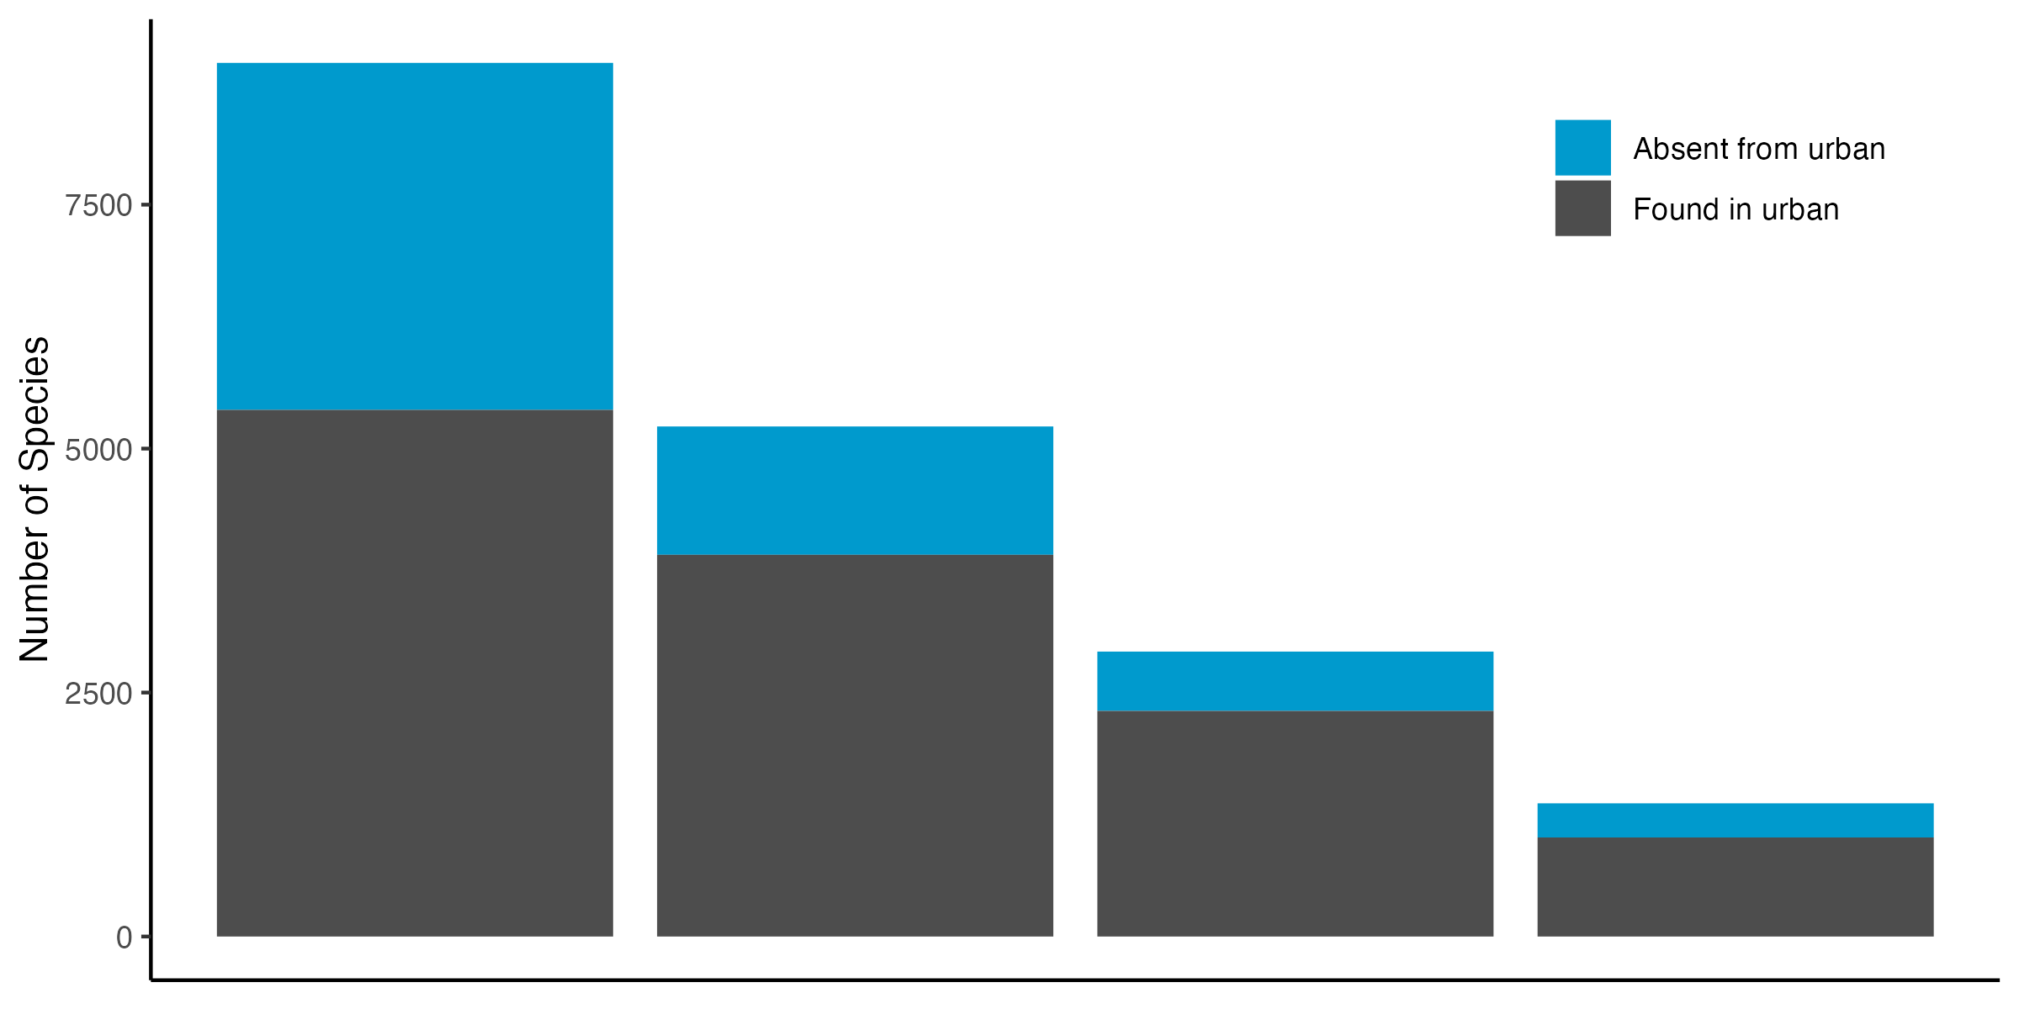
Tropical
Subtropical
Temperate
Subpolar
Tropical
Subtropical
Temperate
Subpolar
Notes:
Idea: Main LDG figure on the left and specialization figure on the right

Slide 3
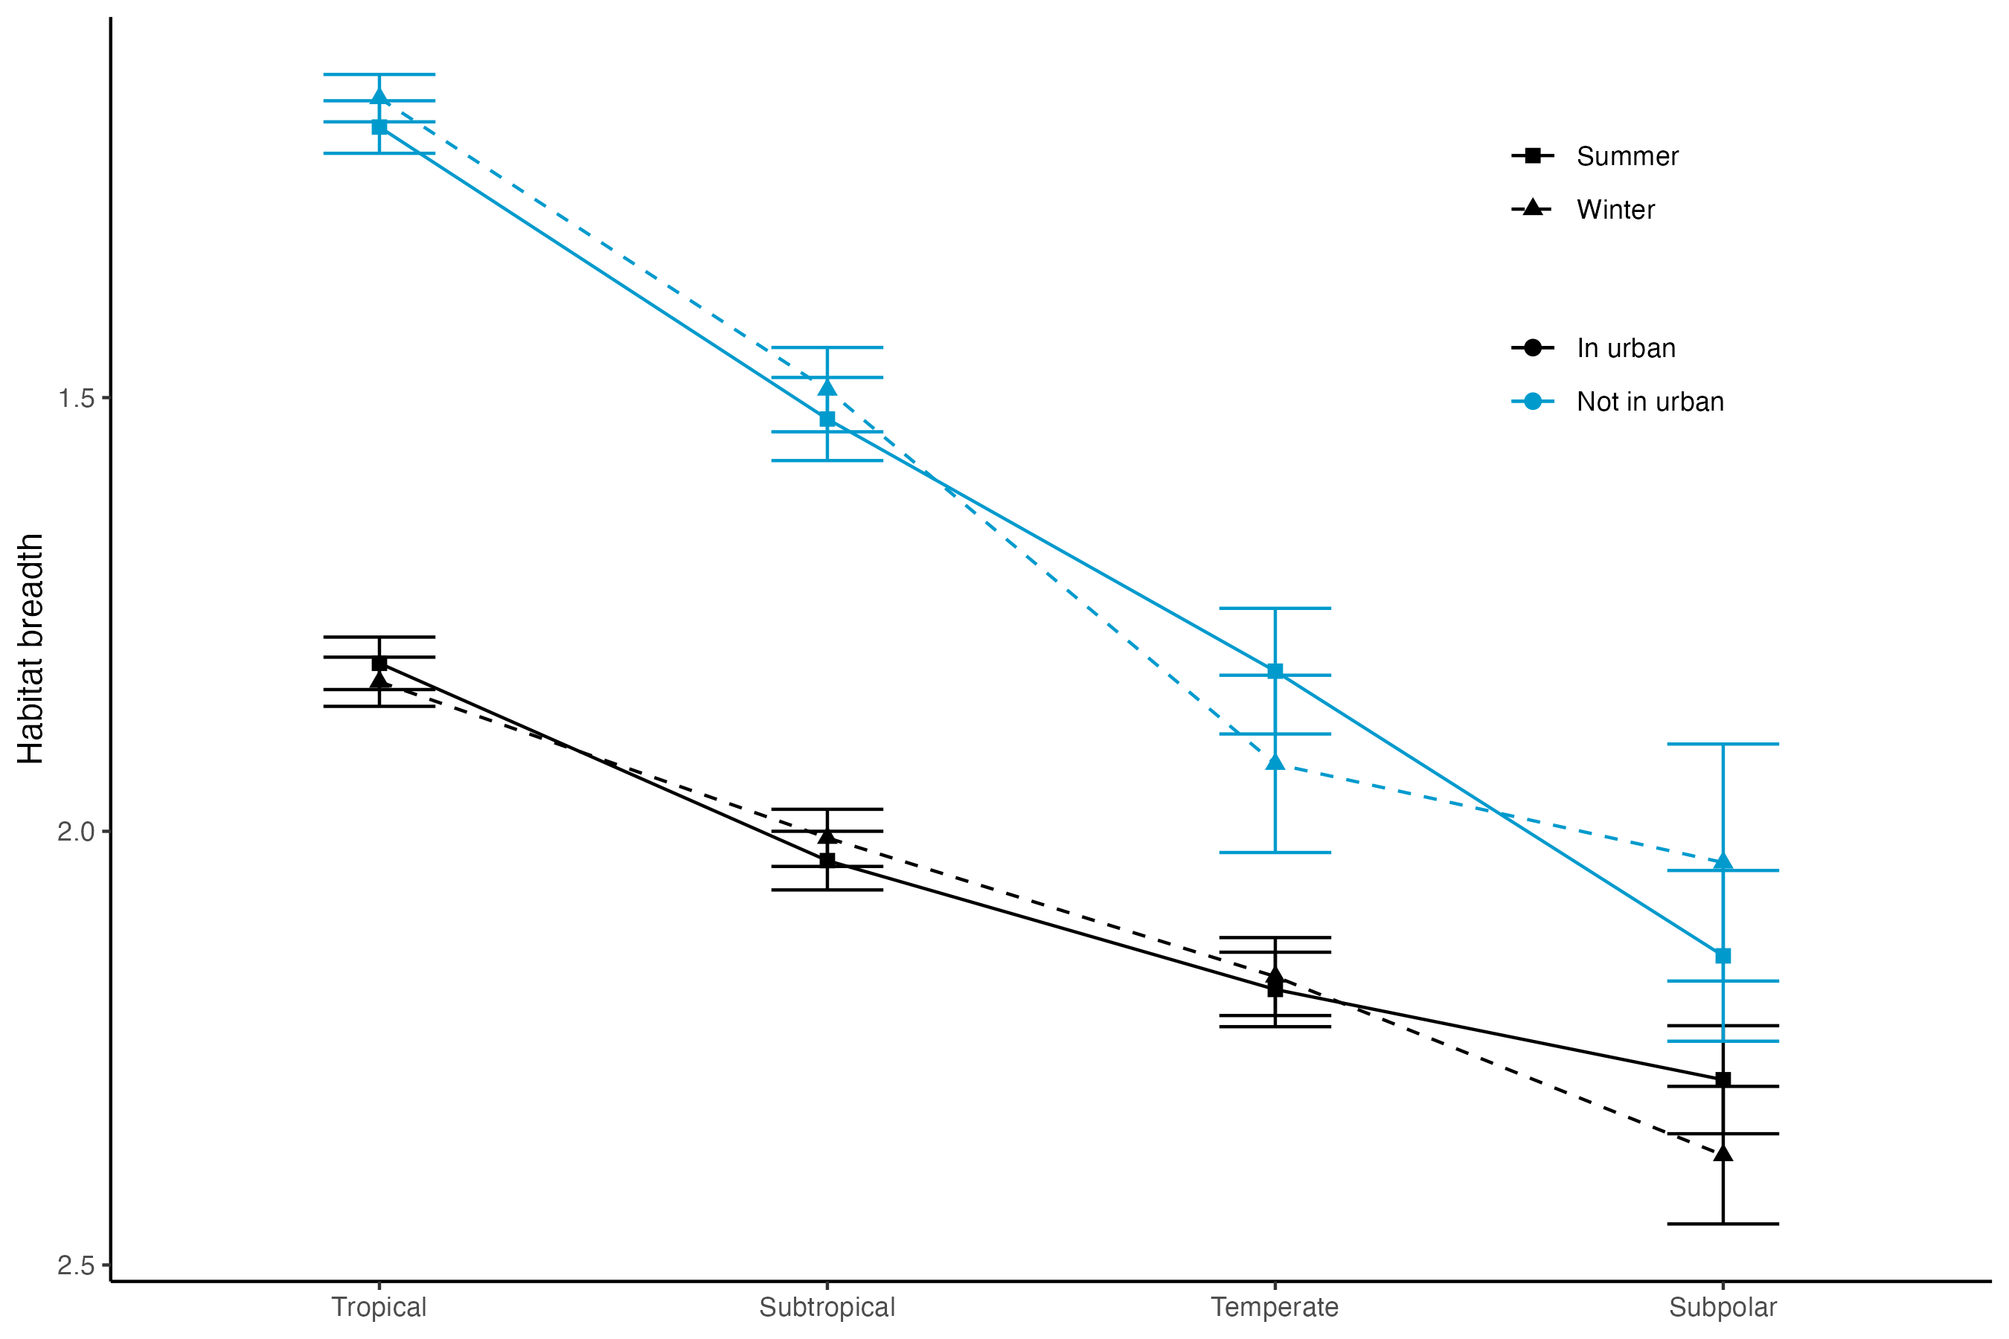
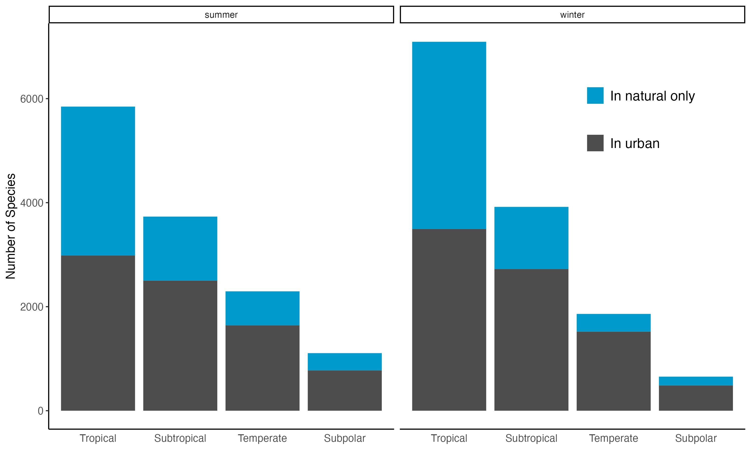
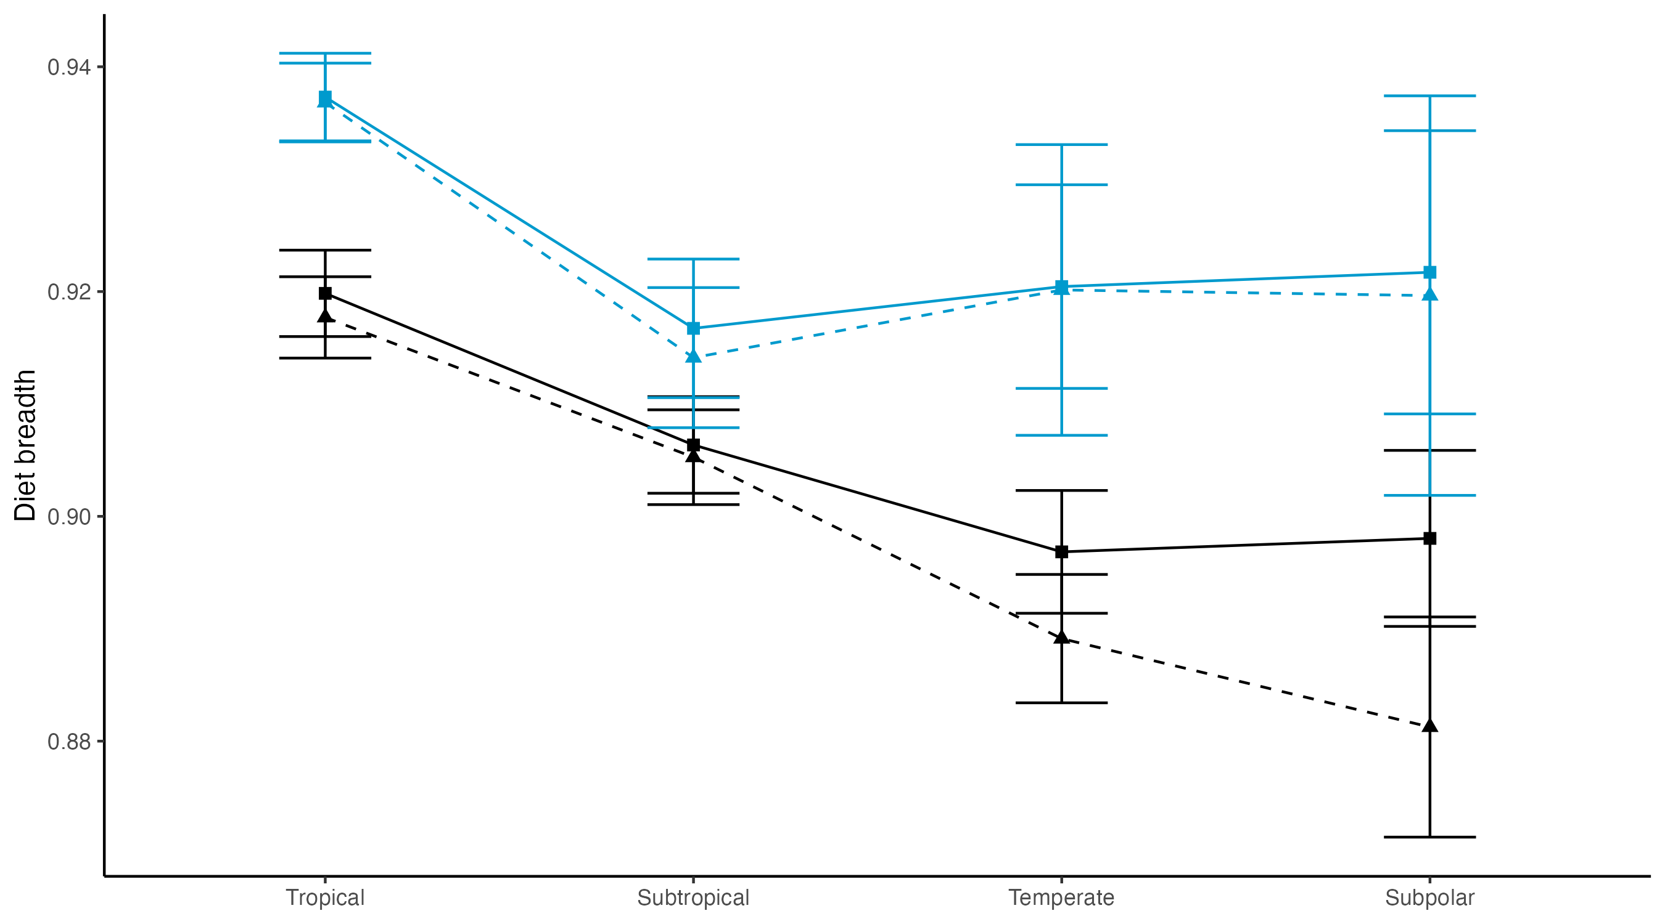
Notes:
Idea: main seasonal figure and insets with the summer pattern in northern and southern hemisphere

Slide 4
FIGURE 1: Map of my points

Slide 5
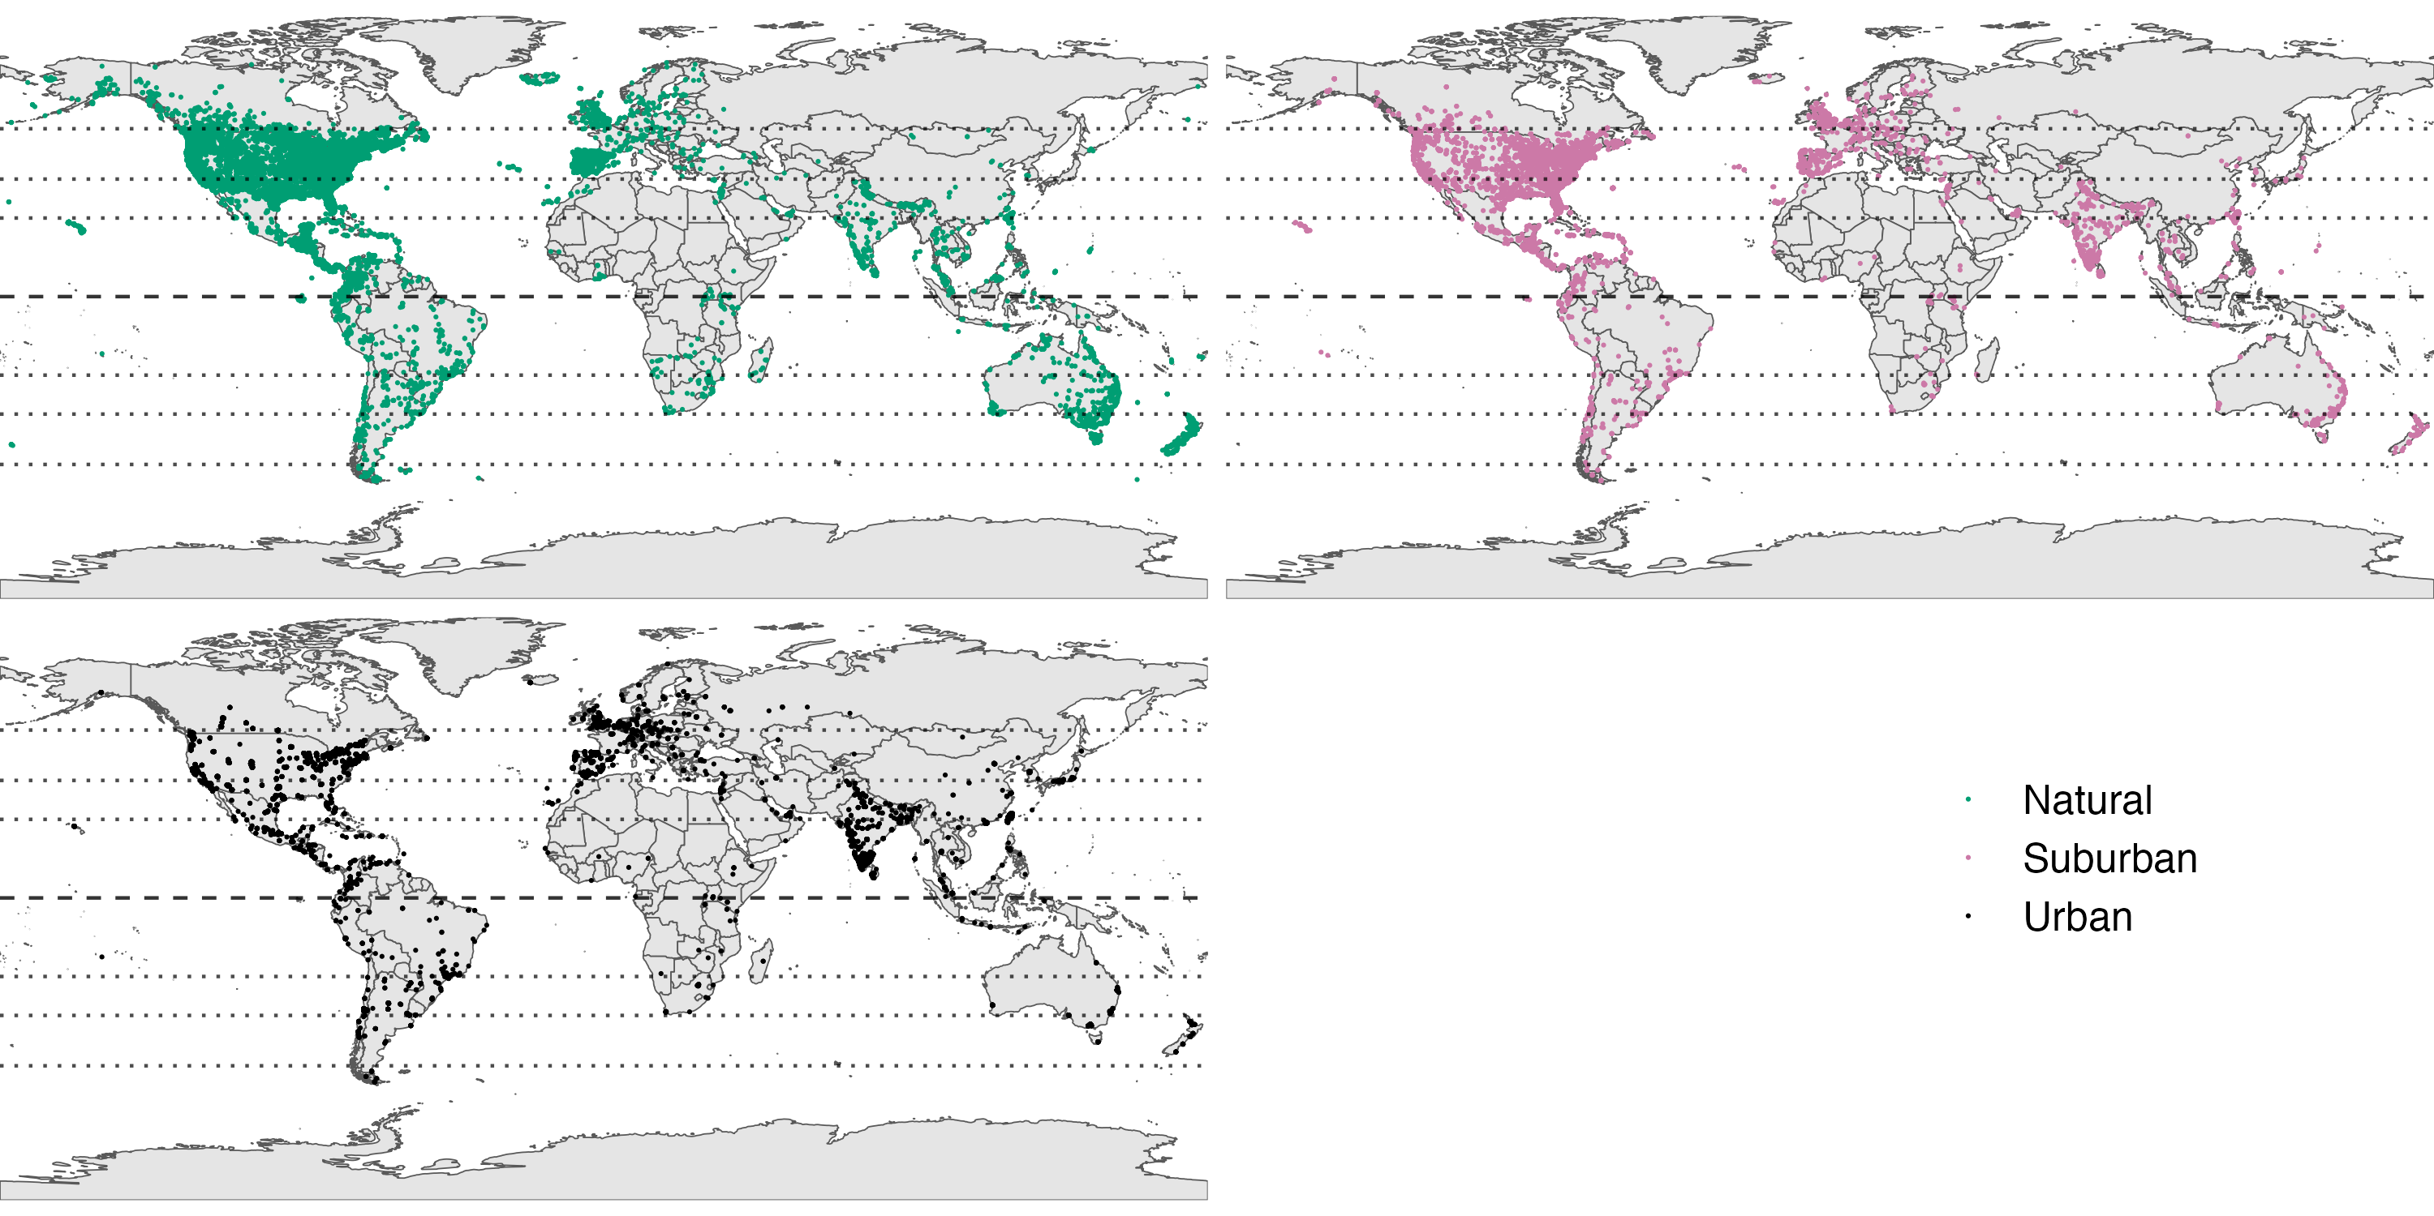
Tropical
Subtropical
Temperate
Subpolar

Slide 6
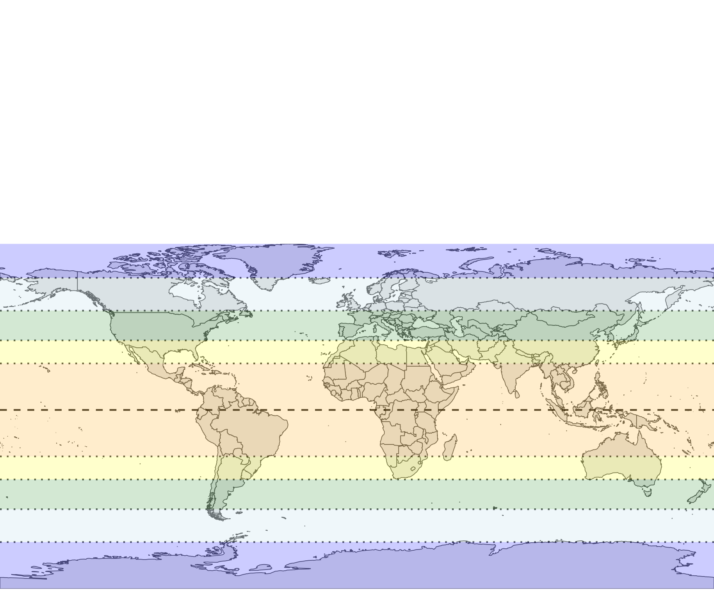
Tropical
Subtropical
Temperate
Subpolar
Polar

Slide 7
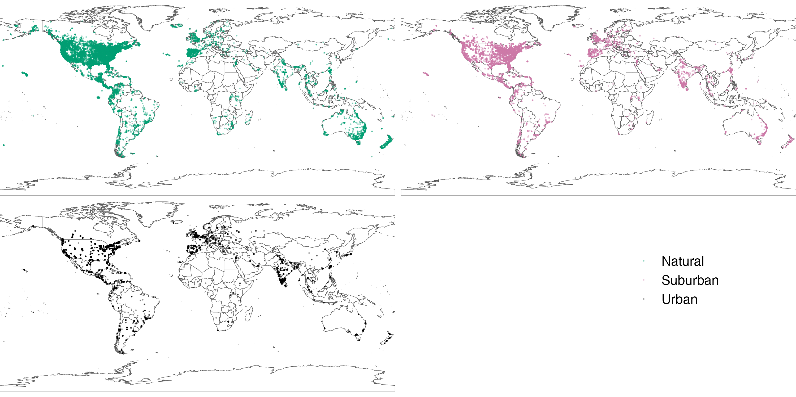
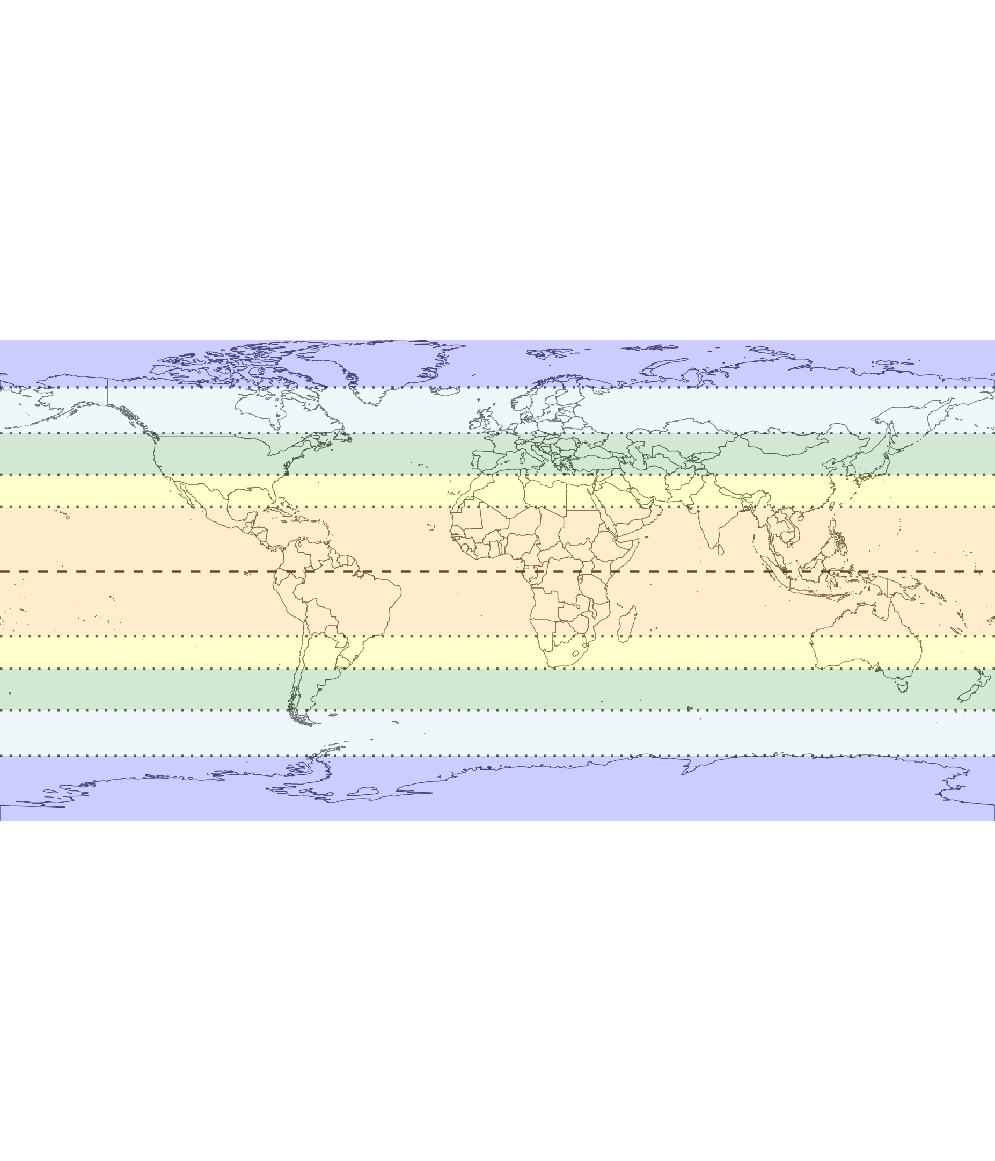

Slide 8
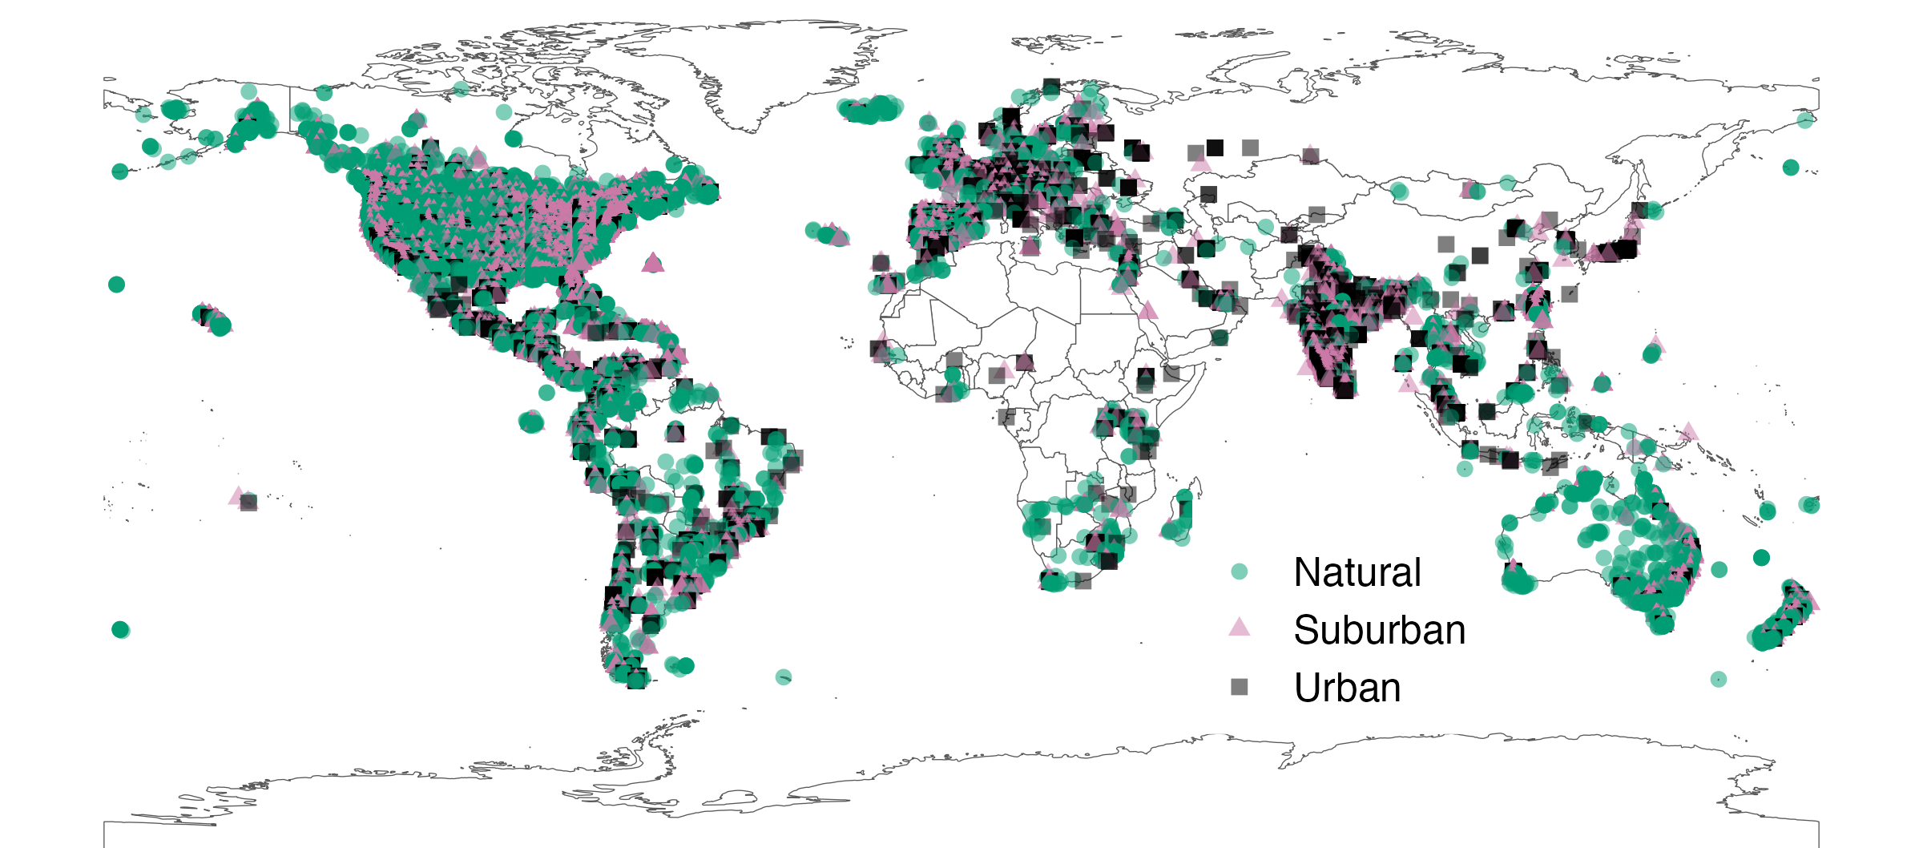
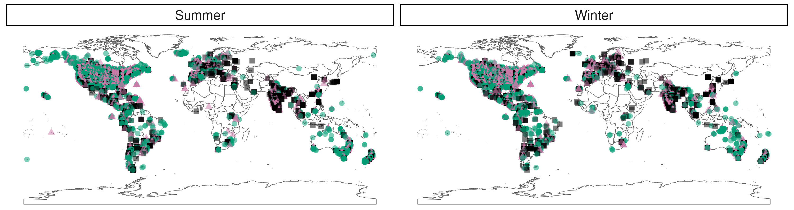
Notes:
Map with every point laid on top of one another.

Slide 9
FIGURE 2: Latitudinal gradient pattern

Slide 10
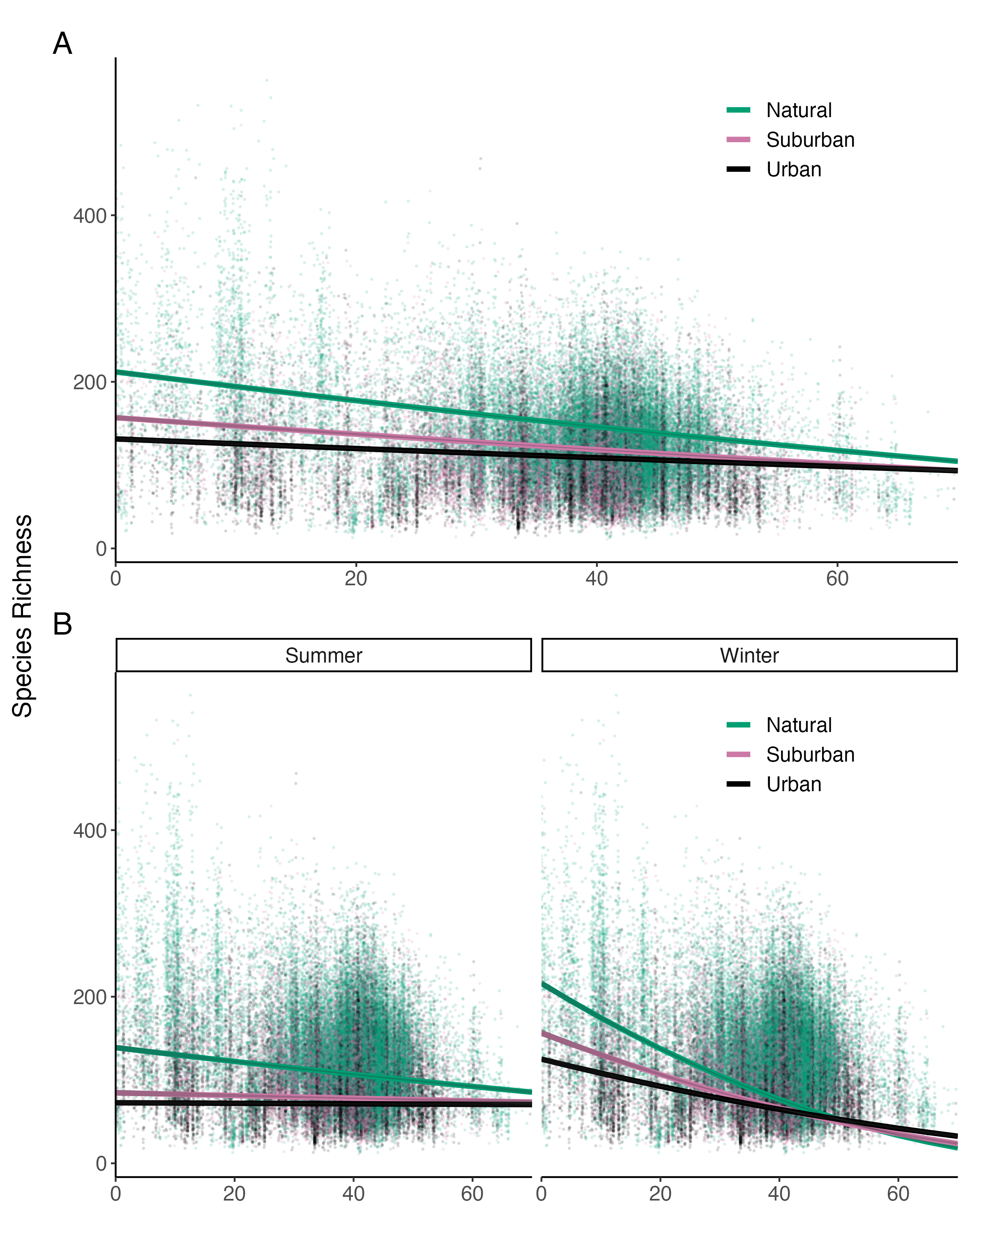
Full model
(no thinning)

Slide 11
Thinned models
Notes:
Putting together the main latitudinal gradient plot with the map

Slide 12
FIGURE 3: Specialization plot

Slide 13
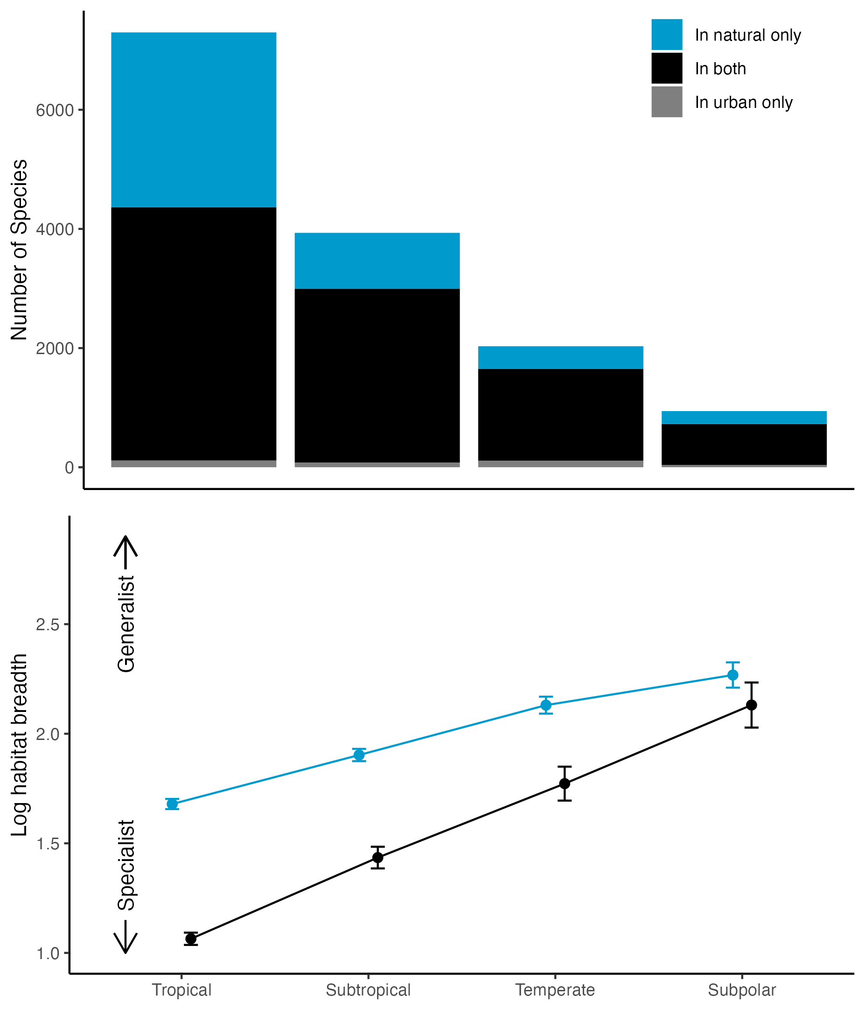
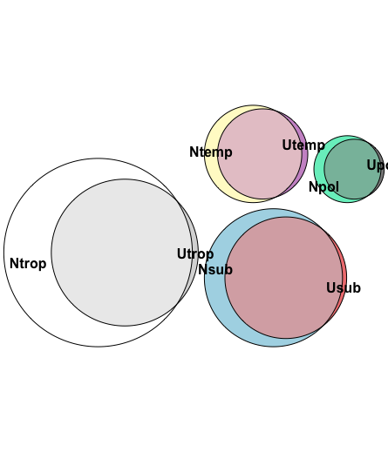
2934
939
4251
383
2918
217
1537
690

Slide 14
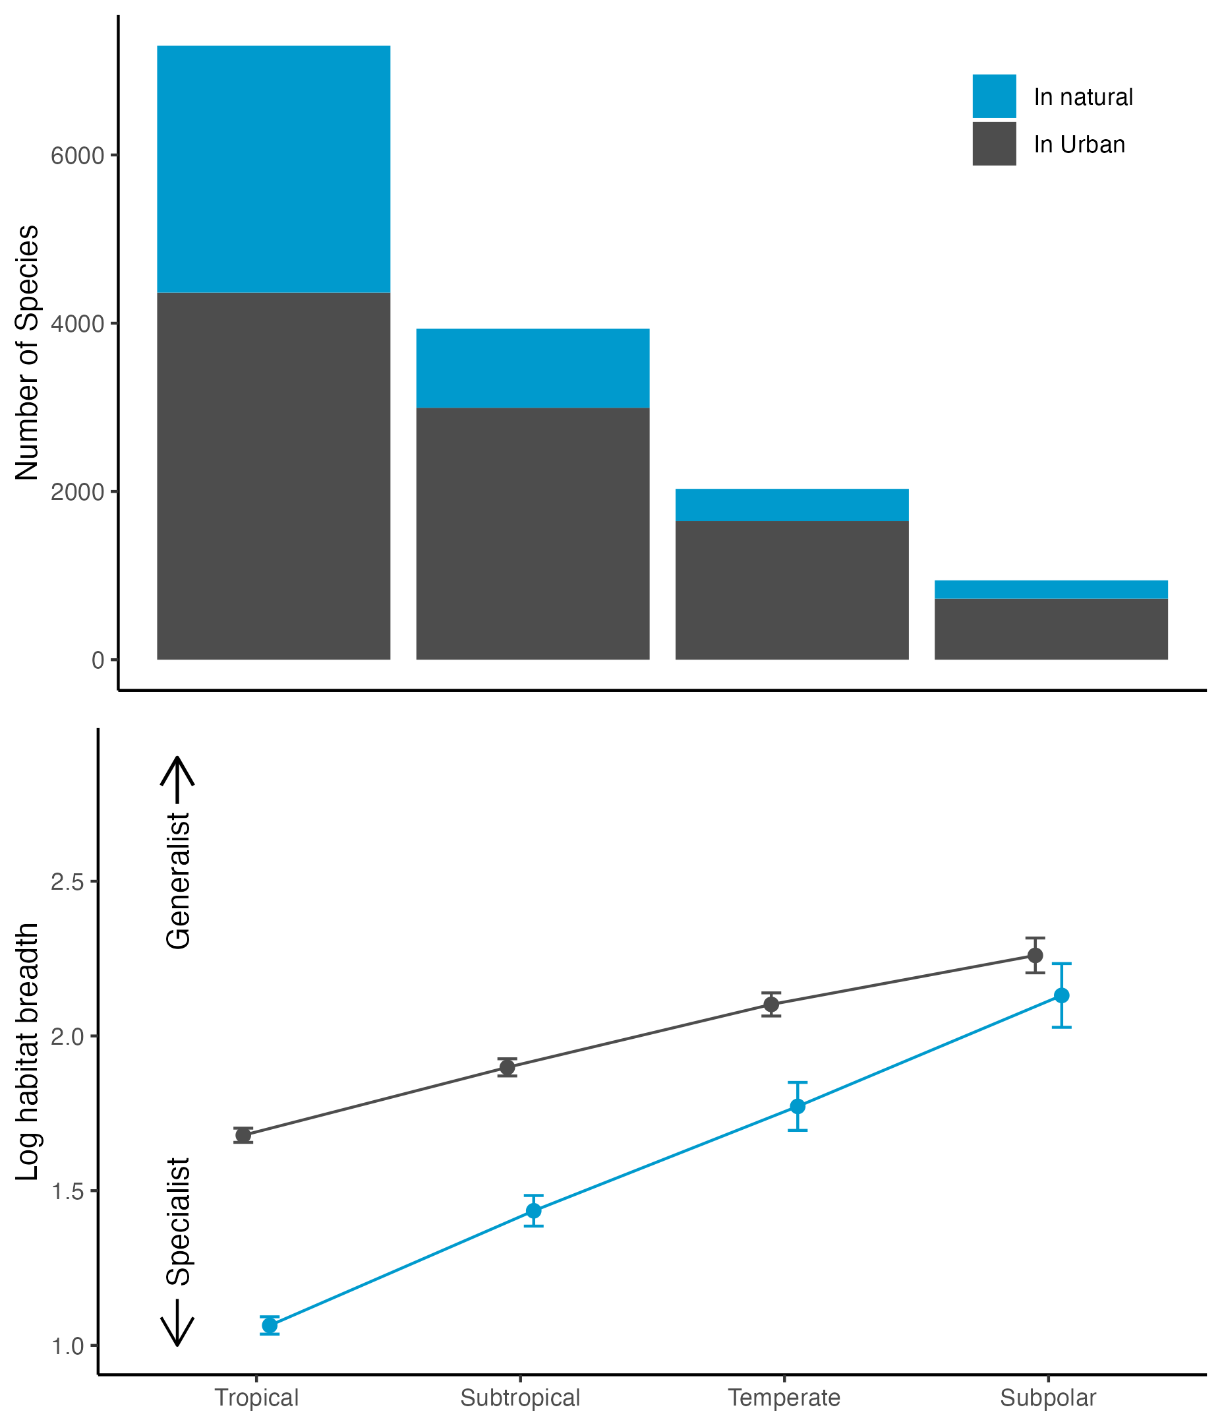

Slide 15
Plot of specialization analyses for both diet and habitat, with bottom axes reversed.

Slide 16
Urban only

Slide 17
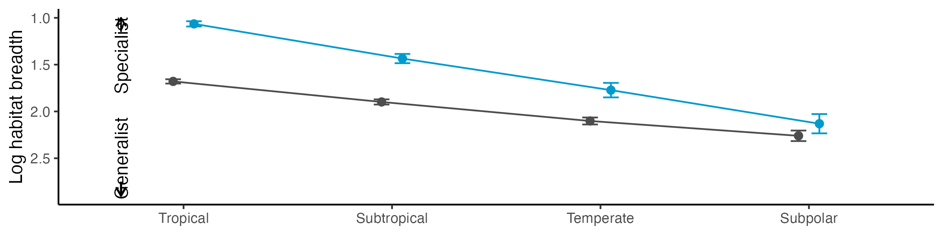
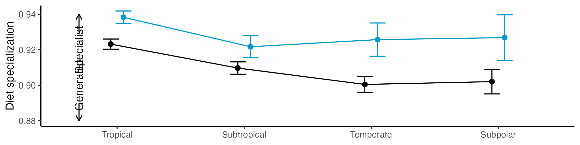

Slide 18
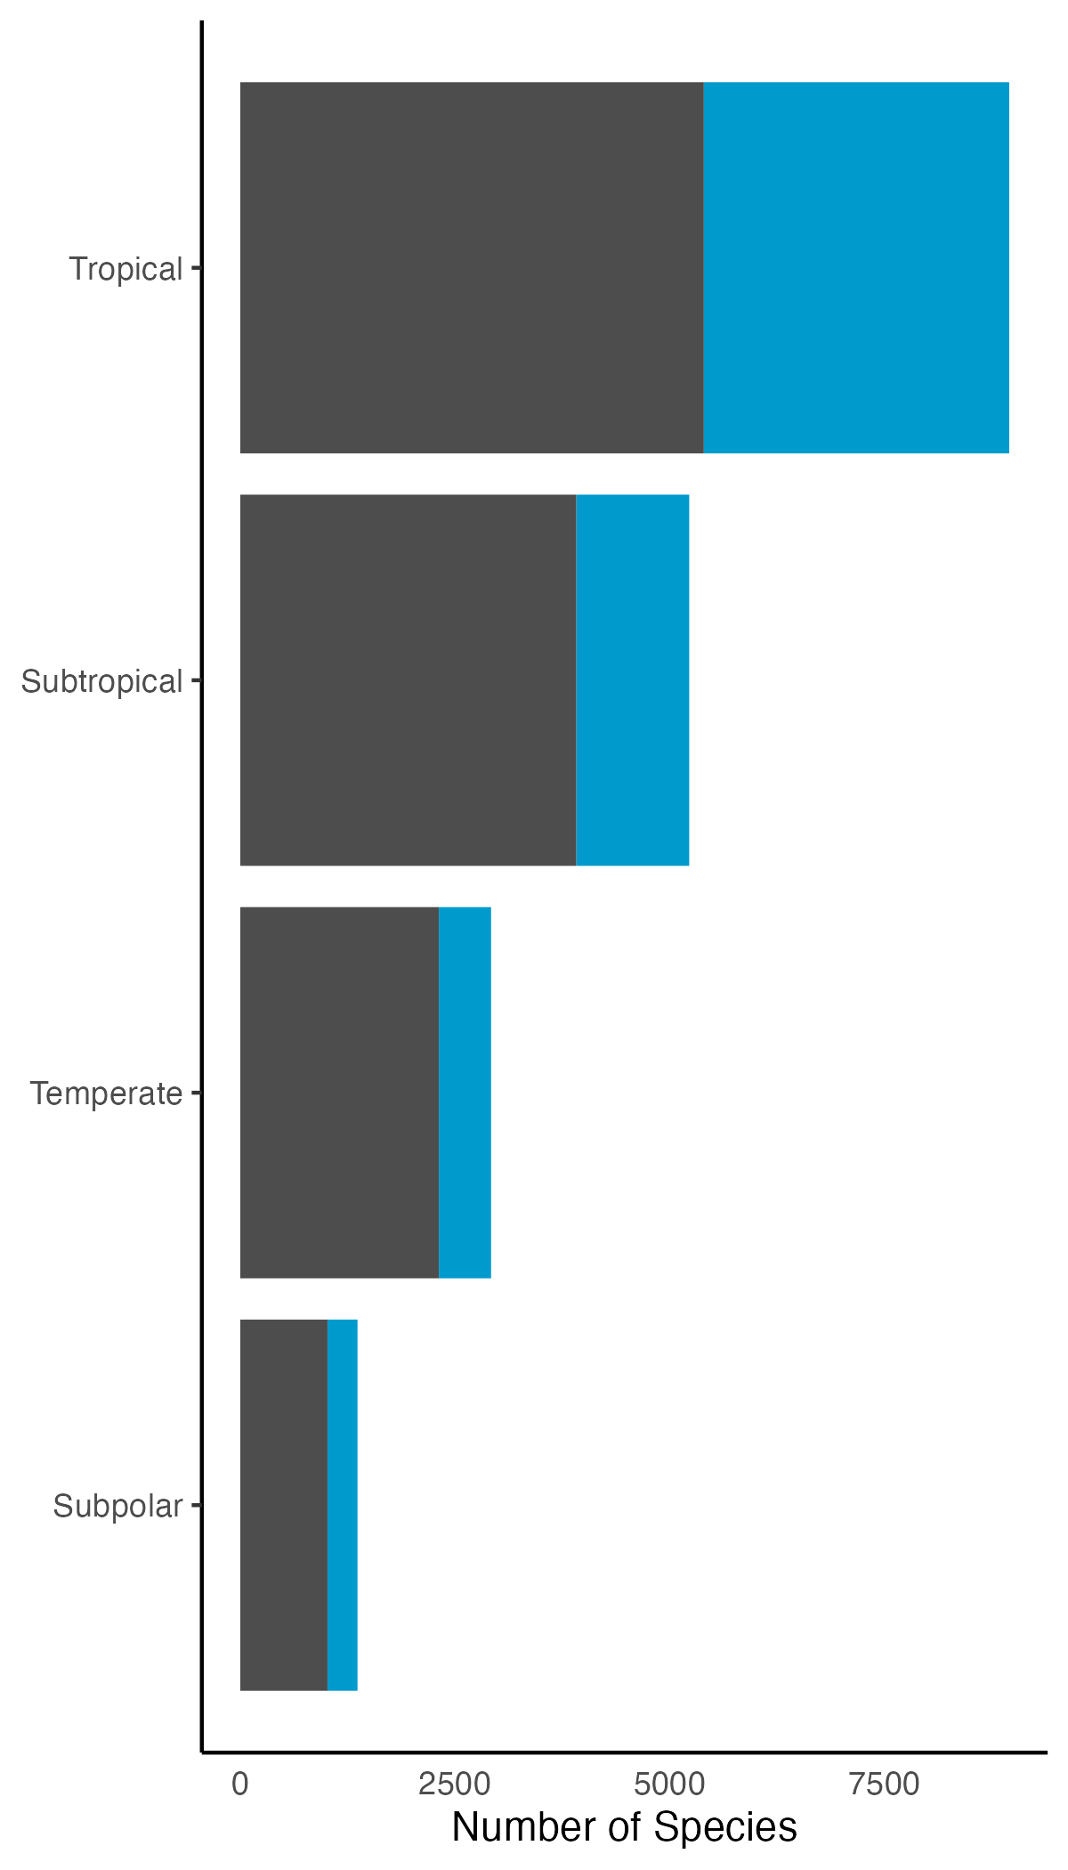

Slide 19

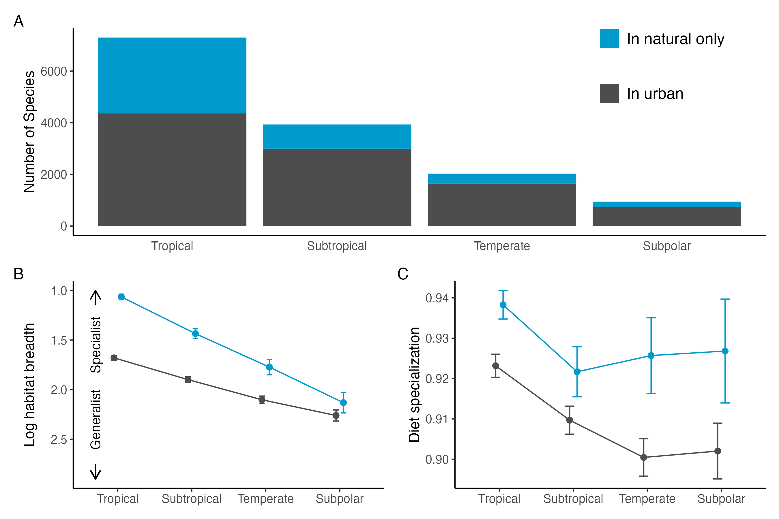

Slide 20
